Slide 1
Introduction to the Science ELC Qualification
All you need to know to get started
1
April 2020
Notes:
Hello and welcome to our quick start guide to Pearson’s ELC Science Qualification
Edexcel Entry Level Certificate in Science is designed for students working below or, at the lower end of the GCSE Combined Science Foundation tier.
It has been specifically designed to meet the needs of these students and their teachers and can be taught as a stand-alone qualification or in conjunction with GCSE Combined Science.
The subject content of the scheme focuses on the key topics and concepts of the Foundation tier course, but at a level that is more accessible and more appropriate to lower attaining students.

Slide 2
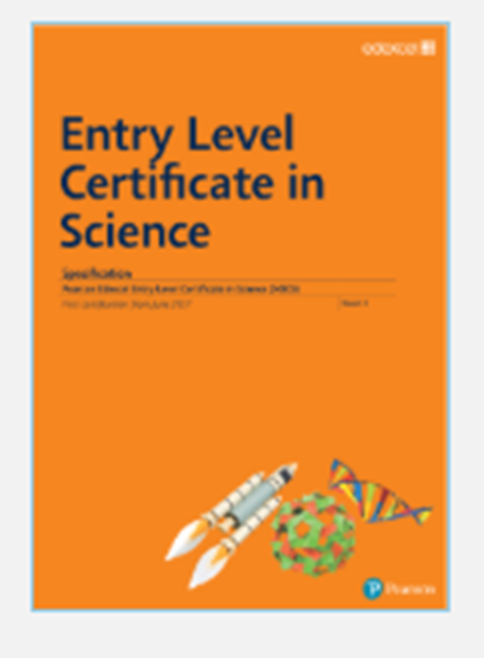
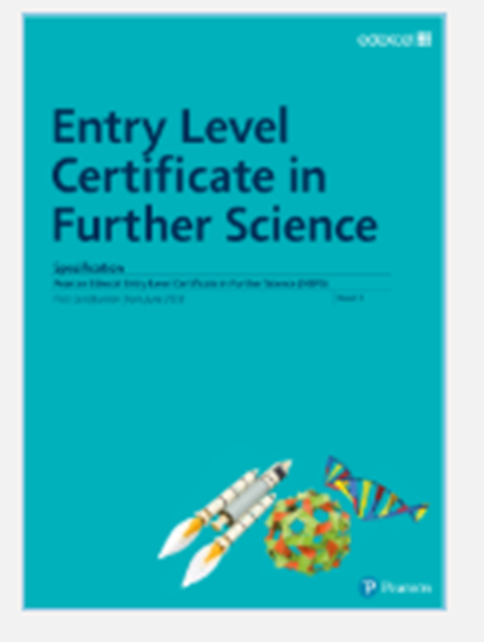
Two separate Entry Level Qualifications
2
Notes:
There are two separate Entry Level Science qualifications. This reflects the “double award nature” of GCSE Combined Science.
One qualification is called the Entry Level Certificate in Science NSC0 and the other is called the Entry Level Certificate in Further Science NSF0.
The content of the NSC0 1st qualification is drawn from the material for papers 1, 3 and 5 of the Edexcel Combined Science Foundation course and the NSF0
“Further Science award” from the material in papers 2, 4 and 6. Candidates can be entered for either the NSC0 Entry Level qualification or the NSF0 Entry Level qualification in “further science” or even for both of the qualifications.
The demand and structure of each award are the same.

Slide 3
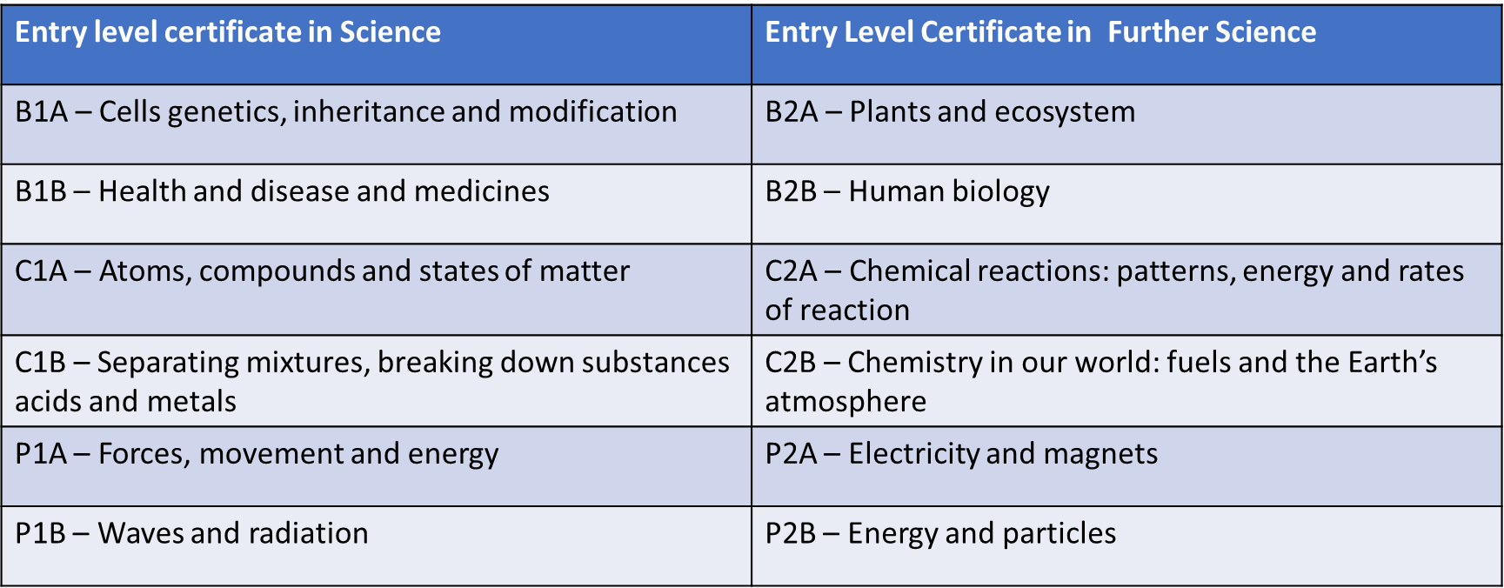
2 qualifications, 6 manageable units in each
Notes:
Each qualification is broken into 6 manageable units; two biology, two chemistry and two physics.
Here you can see how the units are broken up into the units underneath each qualification.
The method of assessment consists of short unit tests which students can sit when they are ready to and at any time during the course.

Slide 4
How ELC fits in with Combined Science
Combined Science Units | ELC – First Certificate | ELC – Further Science Certificate
B1 | Paper 1: Biology 1A Paper 2: Biology 1B
C1 | Paper 3 Chemistry 1A Paper 4: Chemistry 1B
P1 | Paper 5: Physics 1A Paper 6 Physics 1B
B2 |  | Paper 1: Biology 2A Paper 2: Biology 2B
C2 |  | Paper 3: Biology 2A Paper 4: Biology 2B
P2 |  | Paper 5: Physics 2A Paper 6: Physics 2B
Notes:
Remember the ELC course is designed to link closely to the Combined Science course so your students can achieve credit for both the ELC course and have an opportunity to access the questions on the GCSE papers.
This table shows how the ELC units match up with the 6 papers taken for the GCSE in combined Science.

Slide 5
Carefully designed assessments
Notes:
The tests are carefully worded and designed to enable students to demonstrate readily what they have learnt and understood.
Each test consists of 25 marks made up of multiple choice, closed response, short structured answers and short free response questions.
There are no 6 mark open response questions and there are no core practical questions.
Practical skills are assessed through questions based on practical experiences that stem directly from the specification statements.

Slide 6
Tests should be formally supervised
Notes:
The tests should be formally supervised and can be administered in the normal classroom by their current teacher.

Slide 7
Tests – externally set, internally marked.
Image by Davide Bonnazi
Presentation Title Arial Bold 7 pt
7
Notes:
There is no set time for each test and they can be retaken as many times as you judge appropriate to encourage progress and reward and reflect understanding.
However, no feedback or guidance on the candidate’s original answers should be given.
All tests should be kept securely by your centre’s exams officer.

Slide 8
ELC Grading
Level 1 = 30-64
Level 2 = 65-99
Level 3 = 100-150
8
Notes:
The test marks from each test are then added together to determine the student’s level of achievement.
A total of 30 to 64 is level one, 65 to 99 level 2 and 100 to 150 Level 3.
Students do not have to sit all six units for their score to gain an award, although sitting less will inevitably reduce their maximum potential score.
Further details of the assessment arrangements and administration can be found in the Specification documents available online.
Links to relevant documents will be presented at the end of this presentation,

Slide 9
Recognition for all students
Image by Tang Yau Hoong
School leavers will leave with a recognition of their achievement in Science
9
Notes:
A great benefit of the Entry Level Certificate is that it can be used in different ways depending on the ability of your students and the situation they are in.
For some a single Entry Level award followed over two years with the material taught and tested on a unit by unit basis might prove to be most productive and appropriate in meeting and serving the students’ needs.
For slightly stronger students both Entry Level qualifications could be followed over two years: one, one year and the other in the next, or both spread simultaneously over the two year period.
For students working at the lower end of the GCSE Combined Science Foundation tier, the commonality of content between the Entry Level qualification and the Foundation tier Combined Science ,means that students could be co-taught Entry Level Science and Foundation tier Combined Science.
Utilising the simplified content and unit tests of the Entry Level scheme to encourage and build up confidence.

Slide 10
Where can I find out more?
Search: Edexcel Science ELC
Notes:
For further information please follow the link from this slide. Thank you for watching.

